Slide 1
CS 61C: Great Ideas in Computer Architecture Lecture 12: Control & Operating Speed
Krste Asanović & Randy Katz
http://inst.eecs.berkeley.edu/~cs61c/fa17

Slide 2
Agenda
Finish Single-Cycle RISC-V Datapath
Controller
Instruction Timing
Performance Measures
Introduction to Pipelining
Pipelined RISC-V Datapath
And in Conclusion, ...

Slide 3
Recap: Adding branches to datapath
+4
Reg[]
pc
alu
pc
wb
1
1
DataD
Reg[rs1]
ALU
alu
0
DMEM
0
IMEM
inst[11:7]
AddrD
Addr
1
pc+4
Branch Comp.
Reg[rs2]
DataR
wb
inst[19:15]
AddrA
DataA
0
0
DataW
mem
inst[24:20]
AddrB
DataB
1
inst[31:7]
Imm.
Gen
imm[31:0]
PCSel
inst[31:0]
ImmSel
RegWEn
BrUn
BrEq
BrLT
BSel
ASel
ALUSel
MemRW
WBSel

Slide 4
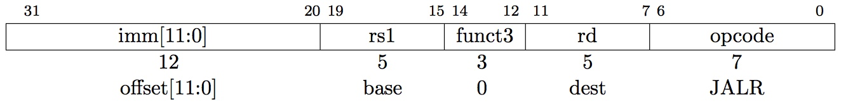
Implementing JALR Instruction (I-Format)
JALR rd, rs, immediate
Writes PC+4 to Reg[rd] (return address)
Sets PC = Reg[rs1] + immediate
Uses same immediates as arithmetic and loads
no multiplication by 2 bytes

Slide 5
Adding jalr to datapath
+4
Reg[]
pc
pc+4
pc
wb
1
alu
1
DataD
Reg[rs1]
ALU
2
alu
0
DMEM
0
IMEM
inst[11:7]
AddrD
Addr
1
pc+4
Branch Comp.
Reg[rs2]
DataR
wb
inst[19:15]
AddrA
DataA
0
0
DataW
mem
inst[24:20]
AddrB
DataB
1
inst[31:7]
Imm.
Gen
imm[31:0]
PCSel
inst[31:0]
ImmSel
RegWEn
BrUn
BrEq
BrLT
BSel
ASel
ALUSel
MemRW
WBSel

Slide 6
Adding jalr to datapath
+4
Reg[]
pc
alu
pc+4
alu
pc
wb
1
1
DataD
Reg[rs1]
ALU
2
0
DMEM
0
IMEM
inst[11:7]
AddrD
Addr
1
pc+4
Branch Comp.
Reg[rs2]
DataR
wb
inst[19:15]
AddrA
DataA
0
0
DataW
mem
inst[24:20]
AddrB
DataB
1
inst[31:7]
Imm.
Gen
imm[31:0]
PCSel
inst[31:0]
ImmSel=I
RegWEn=1
Bsel=1
Asel=0
MemRW=Read
WBSel=2
ALUSel=Add
BrUn=*
BrEq=*
BrLT=*

Slide 7
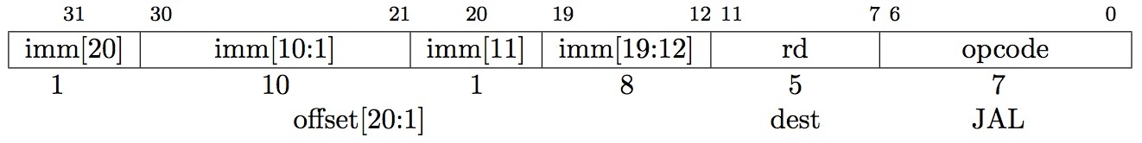
Implementing jal Instruction
JAL saves PC+4 in Reg[rd] (the return address)
Set PC = PC + offset (PC-relative jump)
Target somewhere within ±2¹⁹ locations, 2 bytes apart
±2¹⁸ 32-bit instructions
Immediate encoding optimized similarly to branch instruction to reduce hardware cost

Slide 8
Adding jal to datapath
+4
Reg[]
pc
pc+4
pc
wb
1
alu
1
DataD
Reg[rs1]
ALU
2
alu
0
DMEM
0
IMEM
inst[11:7]
AddrD
Addr
1
pc+4
Branch Comp.
Reg[rs2]
DataR
wb
inst[19:15]
AddrA
DataA
0
0
DataW
mem
inst[24:20]
AddrB
DataB
1
inst[31:7]
Imm.
Gen
imm[31:0]
PCSel
inst[31:0]
ImmSel
RegWEn
BrUn
BrEq
BrLT
BSel
ASel
ALUSel
MemRW
WBSel

Slide 9
Adding jal to datapath
+4
Reg[]
pc
alu
pc+4
alu
pc
wb
1
1
DataD
Reg[rs1]
ALU
2
0
DMEM
0
IMEM
inst[11:7]
AddrD
Addr
1
pc+4
Branch Comp.
Reg[rs2]
DataR
wb
inst[19:15]
AddrA
DataA
0
0
DataW
mem
inst[24:20]
AddrB
DataB
1
inst[31:7]
Imm.
Gen
imm[31:0]
PCSel
inst[31:0]
ImmSel=J
RegWEn=1
Bsel=1
Asel=1
MemRW=Read
WBSel=2
ALUSel=Add
BrUn=*
BrEq=*
BrLT=*

Slide 10
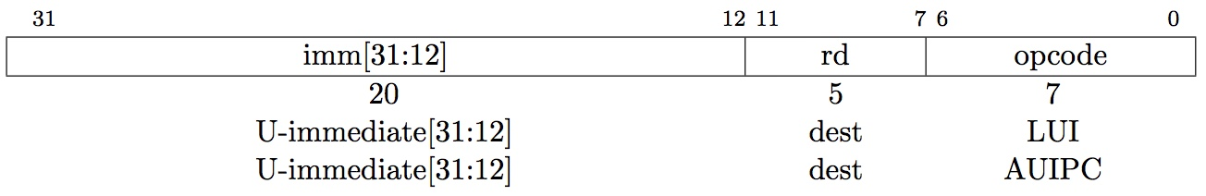
“Upper Immediate” instructions
Has 20-bit immediate in upper 20 bits of 32-bit instruction word
One destination register, rd
Used for two instructions
LUI – Load Upper Immediate (add to zero)
AUIPC – Add Upper Immediate to PC

Slide 11
Implementing lui
+4
Reg[]
pc
pc+4
pc
wb
1
alu
1
DataD
Reg[rs1]
ALU
2
alu
0
DMEM
0
IMEM
inst[11:7]
AddrD
Addr
1
pc+4
Branch Comp.
Reg[rs2]
DataR
wb
inst[19:15]
AddrA
DataA
0
0
DataW
mem
inst[24:20]
AddrB
DataB
1
inst[31:7]
Imm.
Gen
imm[31:0]
PCSel=pc+4
inst[31:0]
ImmSel=U
RegWEn=1
Bsel=1
Asel=*
ALUSel=B
MemRW=Read
WBSel=1
BrUn=*
BrE=*
BrLT=*

Slide 12
Implementing auipc
+4
Reg[]
pc
pc+4
pc
wb
1
alu
1
DataD
Reg[rs1]
ALU
2
alu
0
DMEM
0
IMEM
inst[11:7]
AddrD
Addr
1
pc+4
Branch Comp.
Reg[rs2]
DataR
wb
inst[19:15]
AddrA
DataA
0
0
DataW
mem
inst[24:20]
AddrB
DataB
1
inst[31:7]
Imm.
Gen
imm[31:0]
PCSel=pc+4
inst[31:0]
ImmSel=U
RegWEn=1
Bsel=1
Asel=1
ALUSel=Add
MemRW=0
WBSel=1
BrUn=*
BrE=*
BrLT=*

Slide 13
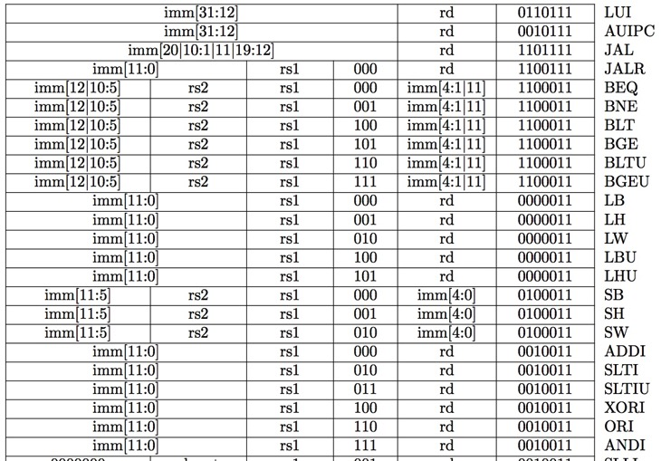
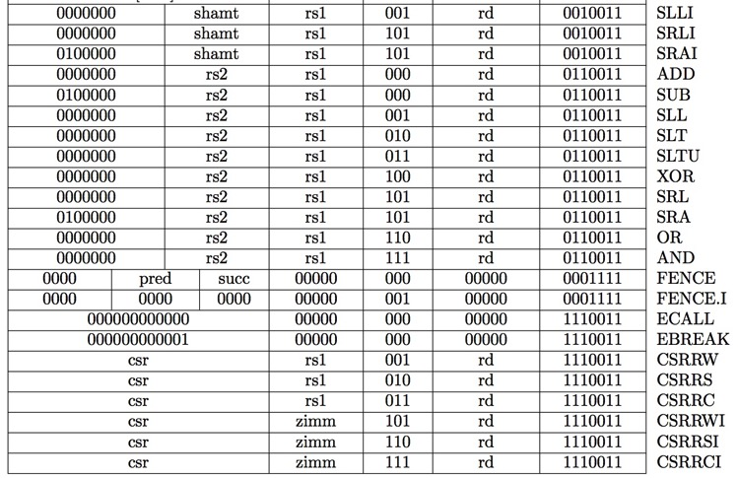
Recap: Complete RV32I ISA
Not in this course
RV32I has 47 instructions total
37 instructions covered in CS61C

Slide 14
Single-Cycle RISC-V RV32I Datapath
+4
Reg[]
pc
pc+4
pc
wb
1
alu
1
DataD
Reg[rs1]
ALU
2
alu
0
DMEM
0
IMEM
inst[11:7]
AddrD
Addr
1
pc+4
Branch Comp.
Reg[rs2]
DataR
wb
inst[19:15]
AddrA
DataA
0
0
DataW
mem
inst[24:20]
AddrB
DataB
1
inst[31:7]
Imm.
Gen
imm[31:0]
PCSel
inst[31:0]
ImmSel
RegWEn
BrUn
BrEq
BrLT
BSel
ASel
ALUSel
MemRW
WBSel

Slide 15
Agenda
Finish Single-Cycle RISC-V Datapath
Controller
Instruction Timing
Performance Measures
Introduction to Pipelining
Pipelined RISC-V Datapath
And in Conclusion, ...

Slide 16
Processor
Processor
Memory
Enable?
Read/Write
Control
Program
Datapath
Address
PC
Bytes
Write Data
Registers
Arithmetic & Logic Unit
(ALU)
Data
Read Data
Processor-Memory Interface

Slide 17
Single-Cycle RISC-V RV32I Datapath
+4
Reg[]
pc
pc+4
pc
wb
1
alu
1
DataD
Reg[rs1]
ALU
2
alu
0
DMEM
0
IMEM
inst[11:7]
AddrD
Addr
1
pc+4
Branch Comp.
Reg[rs2]
DataR
wb
inst[19:15]
AddrA
DataA
0
0
DataW
mem
inst[24:20]
AddrB
DataB
1
inst[31:7]
Imm.
Gen
imm[31:0]
Control Logic
PCSel
inst[31:0]
ImmSel
RegWEn
BrUn
BrEq
BrLT
BSel
ASel
ALUSel
MemRW
WBSel

Slide 18
Control Logic Truth Table (incomplete)
Inst[31:0] | BrEq | BrLT | PCSel | ImmSel | BrUn | ASel | BSel | ALUSel | MemRW | RegWEn | WBSel
add | * | * | +4 | * | * | Reg | Reg | Add | Read | 1 | ALU
sub | * | * | +4 | * | * | Reg | Reg | Sub | Read | 1 | ALU
(R-R Op) | * | * | +4 | * | * | Reg | Reg | (Op) | Read | 1 | ALU
addi | * | * | +4 | I | * | Reg | Imm | Add | Read | 1 | ALU
lw | * | * | +4 | I | * | Reg | Imm | Add | Read | 1 | Mem
sw | * | * | +4 | S | * | Reg | Imm | Add | Write | 0 | *
beq | 0 | * | +4 | B | * | PC | Imm | Add | Read | 0 | *
beq | 1 | * | ALU | B | * | PC | Imm | Add | Read | 0 | *
bne | 0 | * | ALU | B | * | PC | Imm | Add | Read | 0 | *
bne | 1 | * | +4 | B | * | PC | Imm | Add | Read | 0 | *
blt | * | 1 | ALU | B | 0 | PC | Imm | Add | Read | 0 | *
bltu | * | 1 | ALU | B | 1 | PC | Imm | Add | Read | 0 | *
jalr | * | * | ALU | I | * | Reg | Imm | Add | Read | 1 | PC+4
jal | * | * | ALU | J | * | PC | Imm | Add | Read | 1 | PC+4
auipc | * | * | +4 | U | * | PC | Imm | Add | Read | 1 | ALU

Slide 19
Control Realization Options
ROM
“Read-Only Memory”
Regular structure
Can be easily reprogrammed
fix errors
add instructions
Popular when designing control logic manually
Combinatorial Logic
Today, chip designers use logic synthesis tools to convert truth tables to networks of gates

Slide 20
RV32I, a nine-bit ISA!
inst[30]
inst[14:12]
inst[6:2]
Not in CS61C
Instruction type encoded using only 9 bits inst[30],inst[14:12], inst[6:2]

Slide 21
ROM-based Control
11-bit address (inputs)
Inst[30,14:12,6:2]
BrEq
BrLT
9
PCSel
ROM
3
ImmSel[2:0]
BrUn
ASel
BSel
4
ALUSel[3:0]
MemRW
RegWEn
2
WBSel[1:0]
15 data bits (outputs)

Slide 22
ROM Controller Implementation
add
sub
Control Word for add
Control Word for sub
Control Word for or
.
.
.
or
Address
Decoder
Inst[]
BrEQ
BrLT
11
.
.
.
jal
Controller output (PCSel, ImmSel, …)

Slide 23
Administrivia
Homework 2 Due tomorrow 11:59 pm
Project 1 Part 1 Due Monday Oct. 9
Part 2 due Monday Oct. 16
Midterm 1 Regrades due next Tuesday
Talk to a TA if you don’t understand a midterm question or are unsure of a regrade

Slide 24
Break!

Slide 25
Agenda
Finish Single-Cycle RISC-V Datapath
Controller
Instruction Timing
Performance Measures
Introduction to Pipelining
Pipelined RISC-V Datapath
And in Conclusion, ...

Slide 26
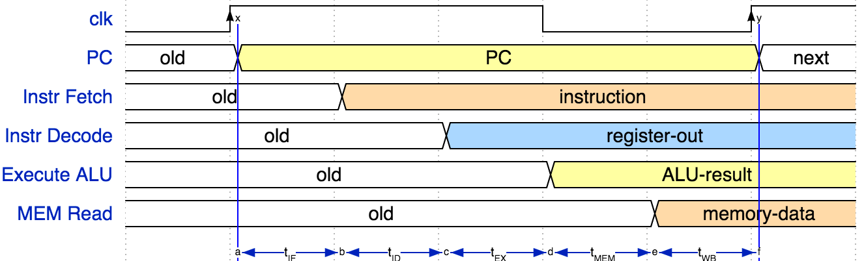
Instruction Timing
IF | ID | EX | MEM | WB | Total
I-MEM | Reg Read | ALU | D-MEM | Reg W
200 ps | 100 ps | 200 ps | 200 ps | 100 ps | 800 ps

Slide 27
Instruction Timing
Instr | IF = 200ps | ID = 100ps | ALU = 200ps | MEM=200ps | WB = 100ps | Total
add | X | X | X |  | X | 600ps
beq | X | X | X |  |  | 500ps
jal | X | X | X |  |  | 500ps
lw | X | X | X | X | X | 800ps
sw | X | X | X | X |  | 700ps
Maximum clock frequency
f_{max} = 1/800ps = 1.25 GHz
Most blocks idle most of the time
E.g. f_{max,ALU} = 1/200ps = 5 GHz!
How can we keep ALU busy all the time?
5 billion adds/sec, rather than just 1.25 billion?
Idea: Factories use three employee shifts - equipment is always busy!

Slide 28
Agenda
Finish Single-Cycle RISC-V Datapath
Controller
Instruction Timing
Performance Measures
Introduction to Pipelining
Pipelined RISC-V Datapath
And in Conclusion, ...

Slide 29
Performance Measures
“Our” RISC-V executes instructions at 1.25 GHz
1 instruction every 800 ps
Can we improve its performance?
What do we mean with this statement?
Not so obvious:
Quicker response time, so one job finishes faster?
More jobs per unit time (e.g. web server returning pages)?
Longer battery life?

Slide 30

Transportation Analogy
 | Sports Car | Bus
Passenger Capacity | 2 | 50
Travel Speed | 200 mph | 50 mph
Gas Mileage | 5 mpg | 2 mpg
50 Mile trip:
 | Sports Car | Bus
Travel Time | 15 min | 60 min
Time for 100 passengers | 750 min | 120 min
Gallons per passenger | 5 gallons | 0.5 gallons
Notes:
“Winner” depends on objectives

Slide 31
Computer Analogy
Transportation | Computer
Trip Time | Program execution time: e.g. time to update display
Time for 100 passengers | Throughput: e.g. number of server requests handled per hour
Gallons per passenger | Energy per task*: e.g. how many movies you can watch per battery charge or energy bill for datacenter
* Note: power is not a good measure, since low-power CPU might run for a long time to complete one task consuming more energy than faster computer running at higher power for a shorter time

Slide 32
“Iron Law” of Processor Performance
Time = Instructions Cycles Time
Program Program * Instruction * Cycle

Slide 33
Instructions per Program
Determined by
Task
Algorithm, e.g. O(N²) vs O(N)
Programming language
Compiler
Instruction Set Architecture (ISA)

Slide 34
(Average) Clock cycles per Instruction
Determined by
ISA
Processor implementation (or microarchitecture)
E.g. for “our” single-cycle RISC-V design, CPI = 1
Complex instructions (e.g. strcpy), CPI >> 1
Superscalar processors, CPI < 1 (next lecture)

Slide 35
Time per Cycle (1/Frequency)
Determined by
Processor microarchitecture (determines critical path through logic gates)
Technology (e.g. 14nm versus 28nm)
Power budget (lower voltages reduce transistor speed)

Slide 36
Speed Tradeoff Example
For some task (e.g. image compression) …
 | Processor A | Processor B
# Instructions | 1 Million | 1.5 Million
Average CPI | 2.5 | 1
Clock rate f | 2.5 GHz | 2 GHz
Execution time | 1 ms | 0.75 ms
Processor B is faster for this task, despite executing more instructions and having a lower clock rate!

Slide 37
Energy per Task
Energy = Instructions Energy
Program Program * Instruction
Energy α Instructions * C V²
Program Program
“Capacitance” depends on
technology,
processor features
e.g. # of cores
Supply voltage,
e.g. 1V
Want to reduce capacitance and voltage to reduce energy/task

Slide 38
Energy Tradeoff Example
“Next-generation” processor
C (Moore’s Law): -15 %
Supply voltage, V_{sup}: -15 %
Energy consumption: 1 - (1-0.85)³ = -39 %
Significantly improved energy efficiency thanks to
Moore’s Law AND
Reduced supply voltage

Slide 39
Energy “Iron Law”
Performance = Power * Energy Efficiency
(Tasks/Second) (Joules/Second) (Tasks/Joule)
Energy efficiency (e.g., instructions/Joule) is key metric in all computing devices
For power-constrained systems (e.g., 20MW datacenter), need better energy efficiency to get more performance at same power
For energy-constrained systems (e.g., 1W phone), need better energy efficiency to prolong battery life

Slide 40
End of Scaling
In recent years, industry has not been able to reduce supply voltage much, as reducing it further would mean increasing “leakage power” where transistor switches don’t fully turn off (more like dimmer switch than on-off switch)
Also, size of transistors and hence capacitance, not shrinking as much as before between transistor generations
Power becomes a growing concern – the “power wall”
Cost-effective air-cooled chip limit around ~150W

Slide 41
Processor Trends
[Olukotun, Hammond,Sutter,Smith,Batten]

Slide 42
Break!

Slide 43
Agenda
Finish Single-Cycle RISC-V Datapath
Controller
Instruction Timing
Performance Measures
Introduction to Pipelining
Pipelined RISC-V Datapath
And in Conclusion, ...

Slide 44



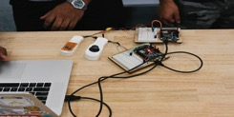
Pipelining
A familiar example:
Getting a university degree
Shortage of Computer scientists (your startup is growing):
How long does it take to educate 16,000?
Year 1
Year 2
Year 3
Year 4

Slide 45




Computer Scientist Education
Option 1: serial
Option 2: pipelining
4000 enter
4000 graduate
4000 graduate
4000 graduate
4000
4 years
4 years
4 years
4 years
16,000 in 16 years, average throughput is 1000/year
16,000 in 7 years
Steady state throughput is 4000/year
Resources used efficiently
4-fold improvement over serial education
1 year
4000 graduate
4000 graduate
4000 graduate
4000 graduate
7 years

Slide 46
Latency versus Throughput
Latency
Time from entering college to graduation
Serial 4 years
Pipelining 4 years
Throughput
Average number of students graduating each year
Serial 1000
Pipelining 4000
Pipelining
Increases throughput (4x in this example)
But does nothing to latency
sometimes worse (additional overhead e.g. for shift transition)

Slide 47
Simultaneous versus Sequential
What happens sequentially?
What happens simultaneously?
4 years
4000 graduate
4000 graduate
4000 graduate
4000 graduate
4000 graduate
4000 graduate
4000 graduate
4000 graduate
4000 graduate
4000 graduate

Slide 48
Agenda
Finish Single-Cycle RISC-V Datapath
Controller
Instruction Timing
Performance Measures
Introduction to Pipelining
Pipelined RISC-V Datapath
And in Conclusion, ...

Slide 49







Pipelining with RISC-V
Phase | Pictogram | t_{step} Serial
Instruction Fetch |  | 200 ps
Reg Read |  | 100 ps
ALU |  | 200 ps
Memory |  | 200 ps
Register Write |  | 100 ps
t_{instruction} |  | 800 ps
t_{cycle} Pipelined
200 ps
200 ps
200 ps
200 ps
200 ps
1000 ps
t_{instruction}
add t0, t1, t2
instruction sequence
or t3, t4, t5
sll t6, t0, t3
t_{cycle}
Notes:
Tc = “Time between completion of instructions”

Slide 50
Pipelining with RISC-V
t_{instruction}
add t0, t1, t2
instruction sequence
or t3, t4, t5
sll t6, t0, t3
t_{cycle}
 | Single Cycle | Pipelining
Timing | t_{step} = 100 … 200 ps | t_{cycle} = 200 ps
 | Register access only 100 ps | All cycles same length
Instruction time, t_{instruction} | = t_{cycle} = 800 ps | 1000 ps
Clock rate, f_{s} | 1/800 ps = 1.25 GHz | 1/200 ps = 5 GHz
Relative speed | 1 x | 4 x
Notes:
Tc = “Time between completion of instructions”

Slide 51
Sequential vs Simultaneous
What happens sequentially, what happens simultaneously?
t_{instruction} = 1000 ps
add t0, t1, t2
or t3, t4, t5
sll t6, t0, t3
instruction sequence
sw t0, 4(t3)
lw t0, 8(t3)
t_{cycle}
= 200 ps
addi t2, t2, 1
Notes:
Tc = “Time between completion of instructions”

Slide 52
Agenda
Finish Single-Cycle RISC-V Datapath
Controller
Instruction Timing
Performance Measures
Introduction to Pipelining
Pipelined RISC-V Datapath
And in Conclusion, ...

Slide 53
And in Conclusion, …
Controller
Tells universal datapath how to execute each instruction
Instruction timing
Set by instruction complexity, architecture, technology
Pipelining increases clock frequency, “instructions per second”
But does not reduce time to complete instruction
Performance measures
Different measures depending on objective
Response time
Jobs / second
Energy per task

